Slide 1
Nonparametric analysis of recurrent events with incomplete observation gaps Jinheum Kim University of Suwon Korea
Joint with Yang-Jin Kim, Eun Hee Choi, Chung Mo Nam

Slide 2
Recurrent event data
Recurrent events arise frequently in clinical trials in which patients are followed longitudinally and response of interest is transient
Examples
Transient ischemic attacks in patients with cerebrovascular disease
Seizures in epileptic patients
Tumor recurrences in cancer patients

Slide 3
Motivating example
Young Traffic Offenders Program(YTOP) data
What is YTOP?
Conducted at the University of Missouri-Columbia Health Sciences Center and other medical centers since late 1987
One-day educational intervention for people under 24 convicted of speeding by 20+ mph over the posted speed limit

Slide 4
YTOP: objective
To evaluate the effect of the program on reducing the rates of speeding violation of young drivers

Slide 5
YTOP: characteristics
Data were collected on 192 young drivers about their speeding violation information since they obtained their driving license
29 subjects(13: YTOP, 16: non-YTOP) received suspensions
These subjects dropped out of the study when the suspension began, and then came back to the study after completing suspension
These intermittent dropouts are called observation gaps
The observation gap is determined by the starting and terminating time of the suspension
BUT, the observation gaps of YTOP data are incomplete due to missing terminating times

Slide 6
Previous works & their limitations
Farmer et al.(2000, Brain Injury): two-sample rank test
Ignore the detailed information about the conviction process
Can assess only the long-term impact
Sun et al.(2001, JASA): nonparametric & semi-parametric methods
Treat YTOP data as recurrent event data
Evaluate both short- and long-term effects applying the conviction process information
Ignore the observation gaps

Slide 7
Previous works & their limitations
Zhao & Sun(2006, CSDA)
Similar to Sun et al. (2001, JASA), but consider the observation gaps
Suspension periods: NOT deterministic, BUT varying and possibly unknown
Kim & Jhun(2008, StatMed)
Treat incomplete observation gaps as terminating times being interval-censored
Only use the first suspension and ignore all the other suspensions after the first one.

Slide 8
Objective of this talk
Use the multivariate-interval censored data to estimate the distribution of the terminating time
Propose a non-parametric test to compare the conviction rates of two groups
Evaluate the proposed test via simulation & reanalyze the YTOP data

Slide 9
Illustrative data: notation
●: conviction time
X: starting time of the suspension
?: terminating times of the suspension (unknown)
■ : end of study time

Slide 10
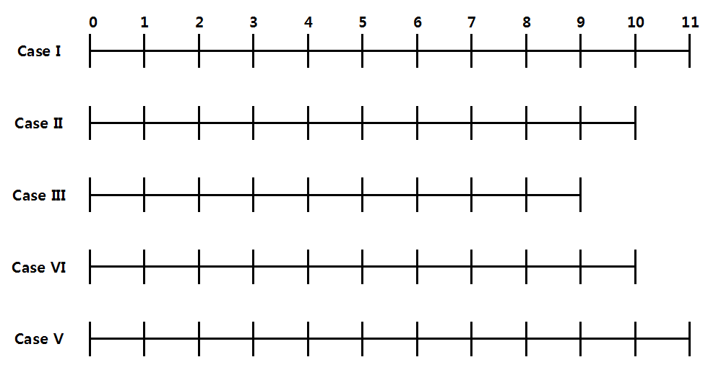
Diagram
?
?
?
?
?

Slide 11
IC data: objective
Want to estimate the distribution of the terminating time using the interval censored data

Slide 12
Two types of IC data
Univariate IC data
cases II, III, & V having one observation gaps
eg: (5,9)], (7, ), (2,10]
Multivariate IC data
case IV having two observation gaps
eg: (2,5]. BUT, …

Slide 13
Multivariate IC data
How can we define the origin time of the second terminating time?

Slide 14
Constructing IC data
Set the origin to be the first conviction time after the previous suspension
eg: For the second suspension of case IV,
Hence, estimate the distribution of the terminating time using

Slide 15
EM-ICM
Hybrid algorithm(Wellner & Zhan, 1997, JASA)
Use R package interval

Slide 16
Notation & assumption
the number of occurrences of the event up to time
function indicating if subject is under observation at time
cumulative mean (frequency) function (CMF)
independent

Slide 17
Data
: the th recurrent event time of subject
: 0-1 indicator whether or not subject has experienced observation gaps
: starting time of the th observation gap of subject

Slide 18
Unobservable terminating times
BUT, the terminating time of each observation gaps is NOT available, that is, interval-censored
So, need to estimate the distribution of the terminating time of the observation gap

Slide 19
IC data
: minimum of greater than
: minimum of greater than
can be right-censored

Slide 20
Terminating time distribution
: the terminating time for the th observation gap of subject
: the mid-point of the th equivalence class
: mass of at

Slide 21
Redefine a risk set
Replace by the estimated expected risk set defined as

Slide 22
Equivalence classes
Case II: (L R]
Case III: (L
Case IV: (L R]
(L R]
Case V: (L R]
Combine L R L L R R
R
Equivalence classes: (2,4], (5,5], (7,9]
Mid-points: 3, 5, 8
Assume with
terminating time

Slide 23
Unadjusted(naive) risk set
1 1 1 1 1 1 1 1 1 1 1 1
1 1 1 1 1 1 0 0 0 1 1
1 1 1 1 1 1 1 1 0 0
1 1 1 0 0 1 1 0 0 1 1
1 1 1 0 0 0 0 0 0 0 1 1

Slide 24
Modified(proposed) risk set
1 1 1 1 1 1 1 1 1 1 1 1
1 1 1 1 1 1 0 0 0 1 1
1 1 1 1 1 1 1 1 0 1
1 1 1 0 p 1 1 1 0 1 1
1 1 1 0 q q r r r 1 1 1

Slide 25
Estimated CMF
Assuming that all subjects have the common CMF,
total number of events observed at time
total number of subjects at risk at time

Slide 26
Representation of estimated CMF
distinct event times across all individuals
Similar to the Nelson-Aalen estimator from survival analysis
Cook & Lawless(2007)

Slide 27
Asymptotic properties
Following Lin et al.(2001, JRSSB),
Consistent
Asymptotically normal with consistently estimated variance,
Approximate pointwise CI:

Slide 28
Comparison of two groups
: the CMFs for group 1 and 2
: the number of subjects in the th group with
: the estimated CMF for the th group

Slide 29
Two-sample test statistic
Hypothesis:
Test statistic:
: maximum follow-up time across two groups
: non-negative predictable function

Slide 30
Asymptotic distribution
Following Cook et al.(1996, BCS) & Lin et al.(2001, JRSSB),
Asymptotically normal with consistently estimated variance,
Hence, asymptotically

Slide 31
Simulation: data generation
Generate the first event time from an exponential distribution with a hazard rate of
Generate
: probability of having an observation gap

Slide 32
Simulation: data generation
If generate the starting time of the first observation gap from
If generate the duration tine from an exponential distribution with a hazard rate of 2 resulting in the terminating time
So, we get & (if )

Slide 33
Simulation: the first cycle of data generation
0
?
0 w/ observation gap
0 w/o observation gap

Slide 34
Two-sample tests: design params
Event rate of each group
Weight:
=0.05, 0.1, 0.2, 0.4
Fixed censoring at 5
Sample size:
Replication: 1,000

Slide 35
Two-sample tests: results(n=100)
 |  | Tests
 |  | Proposed | Naive | Sun et al. | Farmer et al.
0.05 | 1.5 | 0.047 | 0.055 | 0.047 | 0.047
 | 1.4 | 0.271 | 0.273 | 0.263 | 0.190
 | 1.3 | 0.755 | 0.740 | 0.740 | 0.593
 | 1.2 | 0.978 | 0.972 | 0.979 | 0.918
0.1 | 1.5 | 0.060 | 0.055 | 0.056 | 0.039
 | 1.4 | 0.246 | 0.231 | 0.248 | 0.182
 | 1.3. | 0.704 | 0.668 | 0.677 | 0.538
 | 1.2 | 0.981 | 0.966 | 0.980 | 0.907
0.4 | 1.5 | 0.062 | 0.049 | 0.068 | 0.054
 | 1.4 | 0.190 | 0.151 | 0.179 | 0.138
 | 1.3. | 0.633 | 0.440 | 0.576 | 0.423
 | 1.2 | 0.941 | 0.793 | 0.914 | 0.772

Slide 36
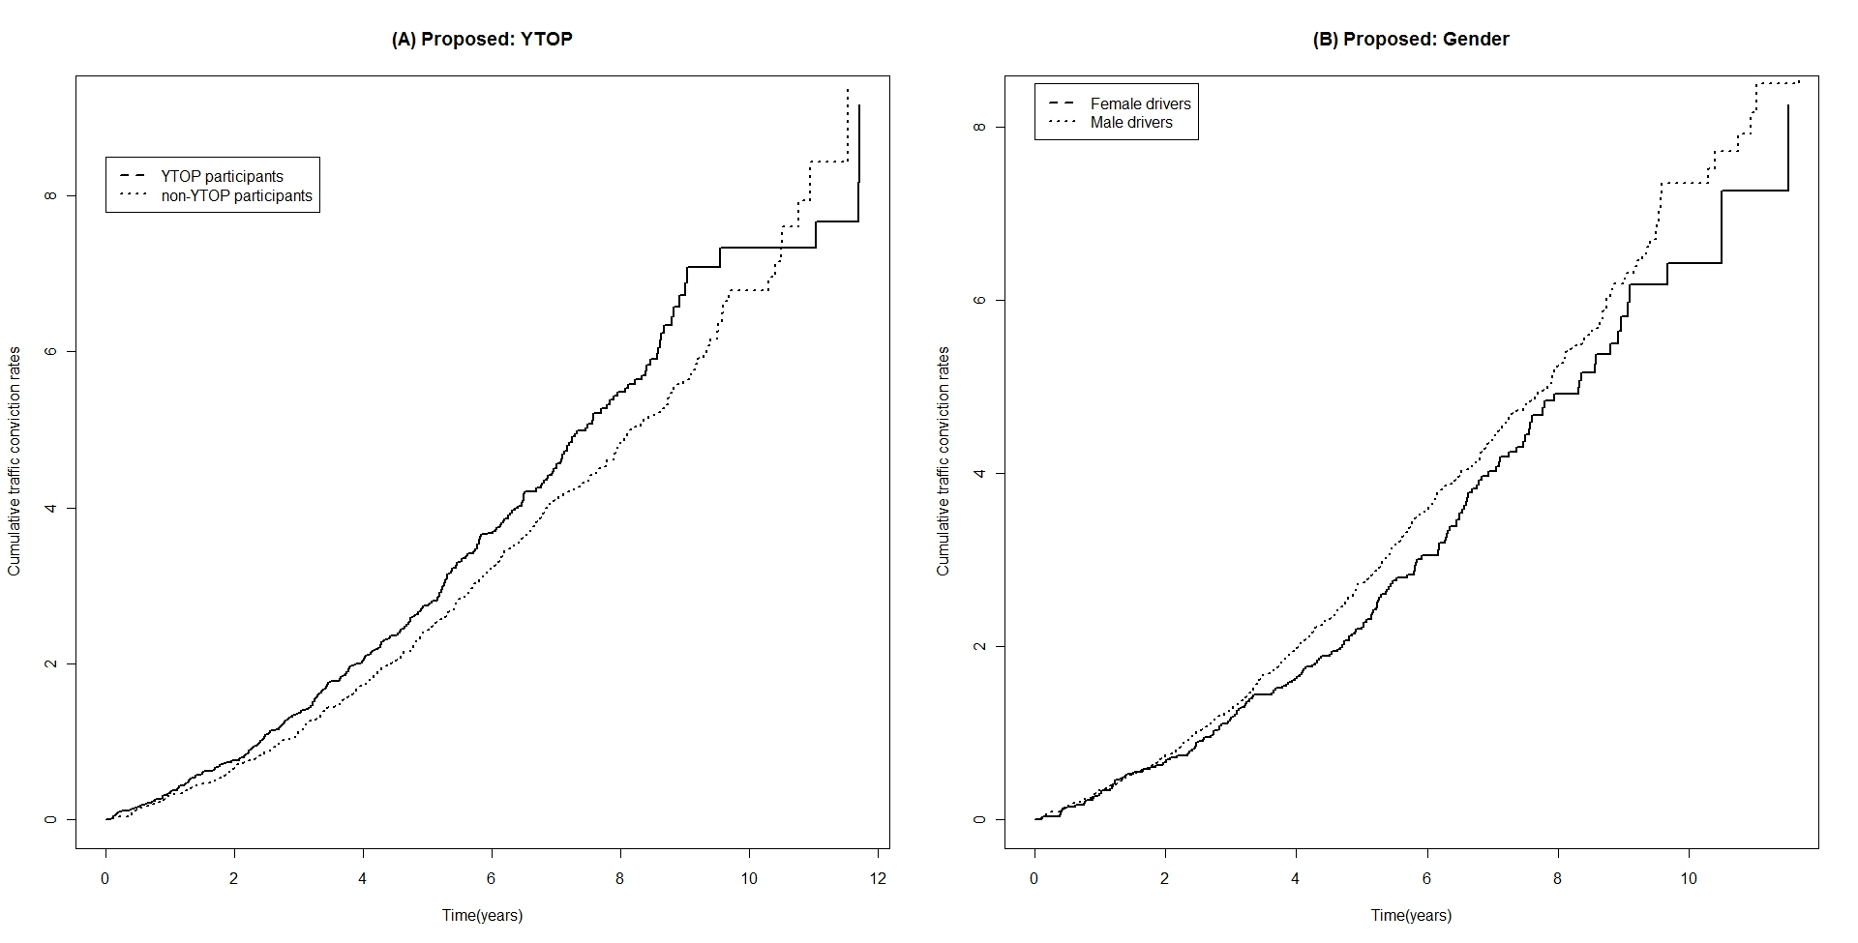
YTOP data: estimated CMFs

Slide 37
YTOP data: p-values
Tests | Covariate
 | YTOP | Gender
Proposed | 0.836 | 0.135
Naive | 0.735 | 0.161
Sun et al. | 0.456 | 0.008
Farmer et al. | 0.113 | 0.533

Slide 38
Summary
Propose the expected risk set to incorporate the observation gaps
Our two-sample test shows to satisfy the level & has the higher power than the other tests
No significant difference in traffic conviction rates between YTOP and non-YTOP participants & between male and female

Slide 39
Extend to …
A regression model to include a time-dependent covariate where denotes the time at which a subject undergoes the traffic education program
A case to allow a termination event such as death

Slide 40
Thank you!

